Slide 2
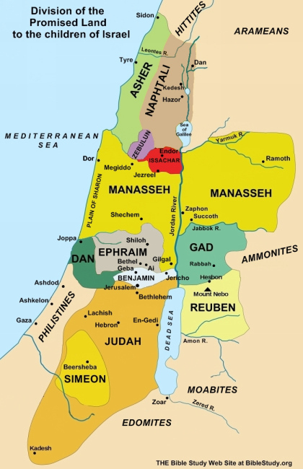

Slide 3
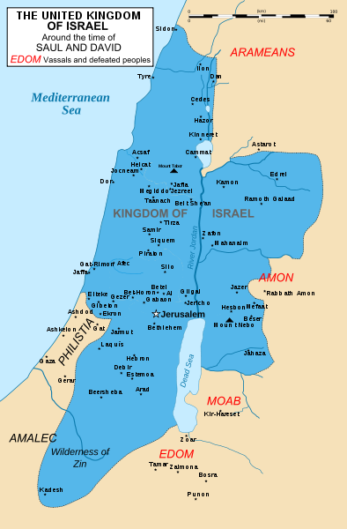

Slide 4
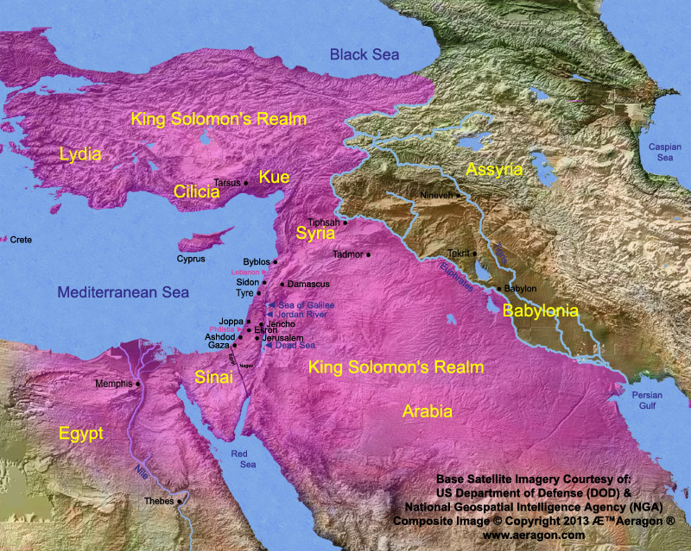
Solomon’s Kingdom

Slide 6
Jeremiah 25:11-12 ¹¹ This whole country will become a desolate wasteland, and these nations will serve the king of Babylon seventy years. ¹² "But when the seventy years are fulfilled, I will punish the king of Babylon and his nation, the land of the Babylonians, for their guilt," declares the LORD, "and will make it desolate forever.

Slide 7
Jeremiah 29:10
¹⁰ This is what the LORD says: "When seventy years are completed for Babylon, I will come to you and fulfill my gracious promise to bring you back to this place.

Slide 8
In 539 b.c., the Persians and Medes under King Cyrus defeated the Babylonians in a fierce battle for world domination. Just as the prophet Daniel had predicted, the Babylonians were so soundly defeated that the capital Babylon opened its city gates to the Persians without a fight (Da.5:1-31).

Slide 9
One year after his conquest of Babylon (538 b.c.), King Cyrus proclaimed himself as the Liberator of the People. He allowed any exile who wished to return to his or her homeland to do so. Among those released were the Jews who had been taken captive at the fall of Jerusalem in 586 b.c.

Slide 10
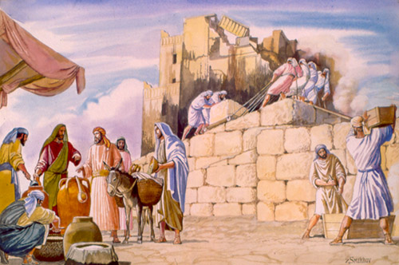
The First Group Returned Under Zerubbabel’s Leadership

Slide 11
But, tragically, these first returnees under Zerubbabel soon drifted back into apostasy. Just as their fathers had done, they too turned away from the Lord, committing sin after sin, such as:

Slide 12
intermarriage with unbelieving neighbors (Mal.2:11; Ezr.9:1-2)
neglecting the worship of the Lord (Mal.1:6-14)
failing to offer sacrifices to the Lord as commanded by Him
participating in witchcraft and sorcery (Mal.3:5)
committing adultery (Mal.3:5)
6. bearing false witness and using profanity (Mal.3:5)

Slide 13
7. oppressing and stealing from people, even the
wages due widows and orphans (Mal.3:5)
mistreating people (Mal.3:5)
failing to fear and show reverence for the Lord (Mal.3:5)
10. disobeying the commandments of the Lord (Mal.3:7)
11. stealing the tithe that belonged to God (Mal.3:8-9)

Slide 14
The Second Group Returned Under Ezra’s Leadership
About 80 years after the first exiles returned to Judah, Ezra secured permission from the Persian king Artaxerxes to lead a second and smaller band of exiles back to Jerusalem. It was the year 458 b.c.,

Slide 15
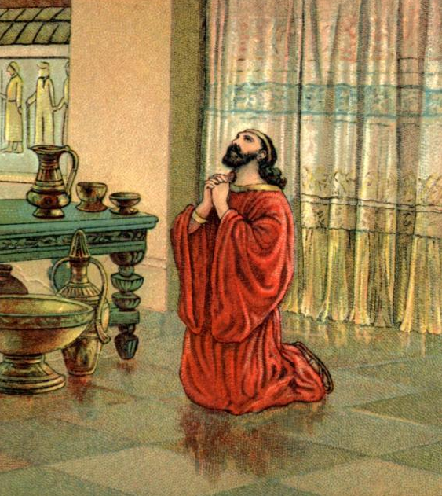
The Third Group Returned Under Nehemiah’s Leadership In 445 b.c.,
The Broken Heart of Nehemiah Over Jerusalem: A Man of Deep Concern and Prayer, 1:1-11.

Slide 16
1. Nehemiah’s distress at hearing the news from Jerusalem: a man of tender heart and genuine concern.
Nehemiah 1:1-4 1 These are the memoirs of Nehemiah son of Hacaliah ² Hanani, one of my brothers, came to visit me with some other men who had just arrived from Judah. I asked them about the Jews who had survived the captivity and about how things were going in Jerusalem.

Slide 17
³ They said to me, "Things are not going well for those who returned to the province of Judah. They are in great trouble and disgrace. The wall of Jerusalem has been torn down, and the gates have been burned.“
⁴ When I heard this, I sat down and wept. In fact, for days I mourned, fasted, and prayed to the God of heaven.

Slide 18
Other Scriptures reveal the dreadful hardships the returned exiles were suffering:
1. They were suffering an economic depression due to famine (5:1-3).
2. A large number of people were suffering oppression due to the greed of certain wealthy farmers and businessmen (5:4-5).
3. The people were suffering persecution in the form of anti-Semitism, ridicule, and harassment from their neighbors and other nationalities who surrounded them (Ezr.4:1-24).
4. The people were defenseless against enemy attacks since the wall of Jerusalem had been torn down and its gates burned with fire (v.3)..

Slide 19
Countless numbers are hurting in countless ways. Like Nehemiah, we must arouse ourselves to show tender concern for the hurting and suffering of this world. We must reach out in compassion to help all we can. Listen to what God’s Holy Word says about caring for other people:

Slide 20
Matthew 25:35-40 ³⁵ For I was hungry, and you fed me. I was thirsty, and you gave me a drink. I was a stranger, and you invited me into your home. ³⁶ I was naked, and you gave me clothing. I was sick, and you cared for me. I was in prison, and you visited me.' ³⁷ "Then these righteous ones will reply, `Lord, when did we ever see you hungry and feed you? Or thirsty and give you something to drink?

Slide 21
³⁸ Or a stranger and show you hospitality? Or naked and give you clothing? ³⁹ When did we ever see you sick or in prison, and visit you?' ⁴⁰ And the King will tell them, `I assure you, when you did it to one of the least of these my brothers and sisters, you were doing it to me!'

Slide 22
Acts 20:35 ³⁵ And I have been a constant example of how you can help the poor by working hard. You should remember the words of the Lord Jesus: `It is more blessed to give than to receive.' "

Slide 23
Romans 12:20-21 ²⁰ Instead, do what the Scriptures say: "If your enemies are hungry, feed them. If they are thirsty, give them something to drink, and they will be ashamed of what they have done to you." ²¹ Don't let evil get the best of you, but conquer evil by doing good.

Slide 24
Galatians 6:2 ² Share each other's troubles and problems, and in this way obey the law of Christ.
Galatians 6:10 ¹⁰ Whenever we have the opportunity, we should do good to everyone, especially to our Christian brothers and sisters.

Slide 25
Hebrews 13:3 ³ Don't forget about those in prison. Suffer with them as though you were there yourself. Share the sorrow of those being mistreated, as though you feel their pain in your own bodies.
1 John 3:17-18 ¹⁷ But if anyone has enough money to live well and sees a brother or sister in need and refuses to help—how can God's love be in that person? ¹⁸ Dear children, let us stop just saying we love each other; let us really show it by our actions.

Slide 26
James 1:27 ²⁷ Pure and lasting religion in the sight of God our Father means that we must care for orphans and widows in their troubles, and refuse to let the world corrupt us.

Slide 27
2. Nehemiah’s prayer: (v.5-11).
Nehemiah became an intercessor, seeking the Lord on behalf of his people. Twelve prayers are recorded in his book, nine of which were offered up by Nehemiah himself.

Slide 28
Nehemiah 2:4 ⁴ The king said to me, "What is it you want?" Then I prayed to the God of heaven,
Nehemiah 4:4 ⁴ Hear us, O our God, for we are despised. Turn their insults back on their own heads. Give them over as plunder in a land of captivity.
Nehemiah 4:9 ⁹ But we prayed to our God and posted a guard day and night to meet this threat.

Slide 29
Nehemiah 5:19 ¹⁹ Remember me with favor, O my God, for all I have done for these people.
Nehemiah 6:9 ⁹ They were just trying to intimidate us, imagining that they could break our resolve and stop the work. So I prayed for strength to continue the work.
Nehemiah 6:14 ¹⁴ Remember, O my God, all the evil things that Tobiah and Sanballat have done. And remember Noadiah the prophet and all the prophets like her who have tried to intimidate me.

Slide 30
Nehemiah 13:14 Remember this good deed, O my God, and do not forget all that I have faithfully done for the Temple of my God.
Nehemiah 13:22 Remember this good deed also, O my God! Have compassion on me according to your great and unfailing love.
Nehemiah 13:29 Remember them, O my God, for they have defiled the priesthood and the promises and vows of the priests and Levites.

Slide 31
Nehemiah 13:31 ³¹ I also made sure that the supply of wood for the altar was brought at the proper times and that the first part of the harvest was collected for the priests. Remember this in my favor, O my God.

Slide 32
In the present Scripture, his prayer is spelled out point by point:
1. First, Nehemiah began his prayer by acknowledging God, praising Him for who He is and what He has done
Nehemiah 1:5 ⁵ Then I said, "O LORD, God of heaven, the great and awesome God who keeps his covenant of unfailing love with those who love him and obey his commands,

Slide 33
2. Second, Nehemiah identified with the people by confessing both their sins and his own before the Lord.
Nehemiah 1:6-7 ⁶ listen to my prayer! Look down and see me praying night and day for your people Israel. I confess that we have sinned against you. Yes, even my own family and I have sinned! ⁷ We have sinned terribly by not obeying the commands, laws, and regulations that you gave us through your servant Moses.

Slide 34
3. Third, Nehemiah pleaded for God’s mercy and help. He asked God to remember His Holy Word, the covenant He had made with His people.
Nehemiah 1:8-10 ⁸ "Please remember what you told your servant Moses: `If you sin, I will scatter you among the nations. ⁹ But if you return to me and obey my commands, even if you are exiled to the ends of the earth, I will bring you back to the place I have chosen for my name to be honored.' ¹⁰ "We are your servants, the people you rescued by your great power and might.

Slide 35
Deuteronomy 4:25-31 ²⁵ "In the future, when you have children and grandchildren and have lived in the land a long time, do not corrupt yourselves by making idols of any kind. This is evil in the sight of the LORD your God and will arouse his anger. ²⁶ "Today I call heaven and earth as witnesses against you. If you disobey me, you will quickly disappear from the land you are crossing the Jordan to occupy. You will live there only a short time; then you will be utterly destroyed. .

Slide 36
27 For the LORD will scatter you among the nations, where only a few of you will survive. ²⁸ There, in a foreign land, you will worship idols made from wood and stone, gods that neither see nor hear nor eat nor smell. ²⁹ From there you will search again for the LORD your God. And if you search for him with all your heart and soul, you will find him. ³⁰ "When those bitter days have come upon you far in the future, you will finally return to the LORD your God and listen to what he tells you. ³¹ For the LORD your God is merciful—he will not abandon you or destroy you or forget the solemn covenant he made with your ancestors.

Slide 37
Lastly, Nehemiah made a very practical request of the Lord. He asked the Lord to make an opportunity for him to approach the king because he wanted to request the king’s help.
Nehemiah 1:11 O Lord, please hear my prayer! Listen to the prayers of those of us who delight in honoring you. Please grant me success now as I go to ask the king for a great favor. Put it into his heart to be kind to me." In those days I was the king's cup-bearer.

Slide 38
Nehemiah illustrated Christ’s intercession.
.
Hebrews 7:25 ²⁵ Therefore Christ is able to save completely those who come to God through him, because he always lives to intercede for them.
Romans 8:34 ³⁴ Who is he that condemns? Christ Jesus, who died--more than that, who was raised to life--is at the right hand of God and is also interceding for us.

